Slide 1


7-1 Final Project
SDLC - Waterfall vs Agile

Slide 2
Scrum Team
Product Owner
-Identify user stories and prioritize them in the backlog for the development team
-Communicate project progress with stakeholders
Scrum Master
-Lead the development team during the sprint
-Communicate progress with the product owner
(Coursera, 2023)

Slide 3
Scrum Team
Development Team
Developers
- Complete technical implementation of user stories
-Help the scrum master estimate timeline for the sprint
Testers
-Describe test cases for all user stories
-Test all cases pass for given inputs producing expected outputs
(Coursera, 2023)

Slide 4
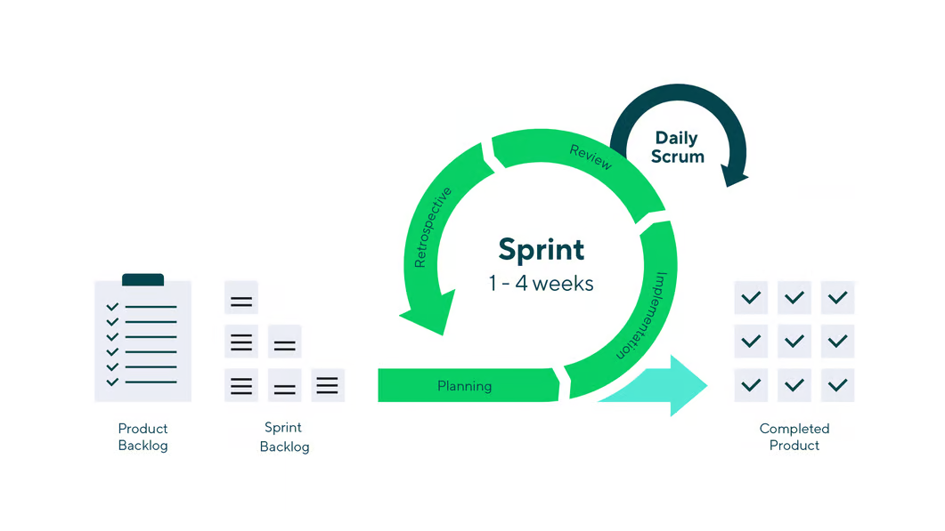
Phases of the Scrum-Agile SDLC
Product Backlog Creation
Sprint Planning and Sprint Backlog Creation
Working on the Sprint. Daily Scrum Meetings
Product Increment and Sprint Review
Retrospective and Next Sprint Planning
(Gurendo, 2020)

Slide 5
Agile SDLC: Backlog and Planning
Product Backlog Creation
User defined needs and wants are turned into "user stories" and added to the overall project backlog.
Sprint Planning and Sprint Backlog Creation
Product owner prioritizes the backlog with most relevant features first
Development team and Scrum Master "groom" backlog and assign time estimates to prepare for sprint
(Gurendo, 2020)

Slide 6
Agile SDLC: Working on the sprint
The Scrum Master and development team have a daily Scrum to discuss yesterday's work, today's goals, and any impediments
User stories are converted into working features during this sprint period, lasting 2-4 weeks
Testers check that there test cases all pass before the features can be approved
(Gurendo, 2020)

Slide 7
Agile SDLC: Incremental Release and Retrospective
Product owner approves incremental release and presents it to the stakeholders
Scrum Master and team hold a sprint retrospective to reflect on accomplishments and any struggles
Feedback from stakeholders is incorporated into upcoming sprint
The backlog is updated and prepared for the next sprint
(Gurendo, 2020)

Slide 8
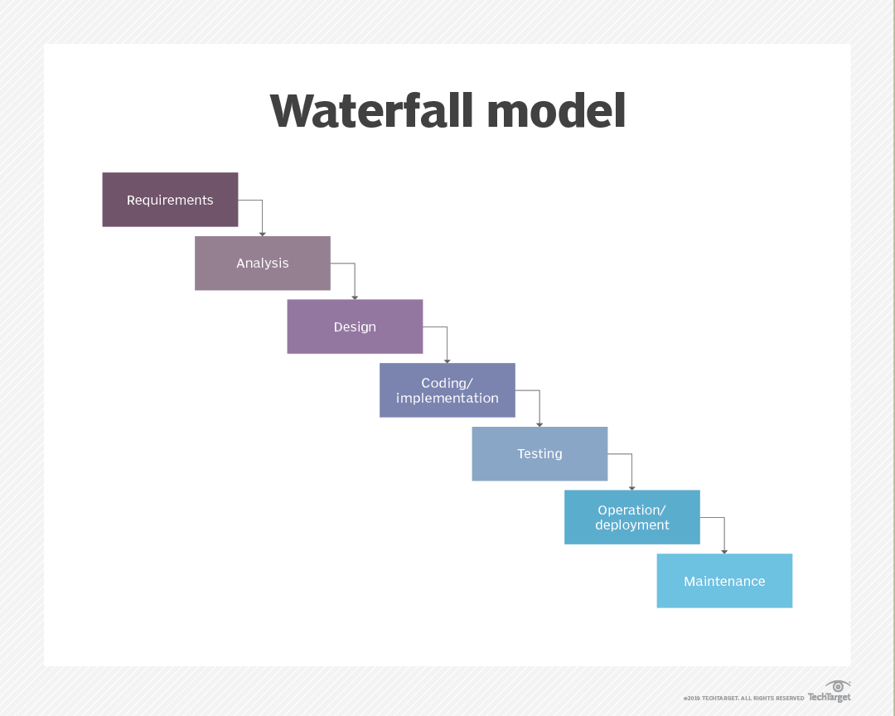
Waterfall SDLC
Requirements
Analysis
Design
Coding and implementation
Testing
Operation and deployment
Maintenance
(Lutkevich, n.d.)

Slide 9
Changing requirements:
Waterfall VS Scrum-Agile
Example: Design is changed from single-page list to slideshow.
Waterfall response: Since changes to the design are not built into the waterfall approach, management would either have to come up with an ad-hoc and non-standard solution or would have to deny the client the change altogether, especially depending on how much coding had taken place.
Agile-scrum response: Given that each task already has a time estimate, the affected user stories could be updated to include the new design elements. In case coding had already taken place, the Product owner could prioritize the work to change in the current sprint, or delay the feature for the new design in the next sprint.

Slide 10
Agile VS Waterfall:
How to decide?
Size of project
Is the project large enough to require more than 3 developers?
Smaller projects fit well with Waterfall
Type of project (utility centric vs user-centric)
Is the design for something like a device analog, like a calculator or a media player, or does the design include extra features to make the experience more user-focused?
Complex, user-centric projects are a good fit for Scrum-Agile
Definition of problem/solution space
Is the problem well understood or are there unknown and new technologies at play?
An uncertain path through technical challenges benefits from Scrum-Agile

Slide 11
References
Coursera (2023). The 3 Scrum Roles and Responsibilities Explained. Coursera. https://www.coursera.org/articles/scrum-roles-and-responsibilities
Gurendo, D (2020). Software Development Life Cycle (SDLC). Scrum Model Step by Step. XBSoftware. https://xbsoftware.com/blog/software-development-life-cycle-sdlc-scrum-step-step/
Lutkevich, B (n.d.). waterfall model. TechTaret. https://www.techtarget.com/searchsoftwarequality/definition/waterfall-model

